Slide 1




DYNAMIC MODELLING
& DIGITAL TWIN
OF ELECTRIC CABLE SHOVELS
Payload estimation and physics-informed digital twin development
Suhail Majeed Sheikh
Junior Research Fellow, Mining Engineering, IIT Kharagpur
Supervisor: Prof. Sunita Mishra
CMPDI Progress Review | 1–2 November 2026
Notes:
Cover artwork is stylised vector illustration, not a photograph or a result. Technical cutoff 7 Sep 2026 (repo commit 460d872).

Slide 2
PROJECT AND MY CONTRIBUTION
Parent CMPDI project
AI-enabled platform for diagnosis, prognosis and health management of mining electrical systems (Project MT-189)
PI: Prof. A. Routray; Joint-PI: Prof. S. Mishra
Primary field site shifted from dragline to electric rope shovel (AC-drive mandate), with NCL concurrence, April 2026
Work elements WE-1 … WE-7: modelling, prior, sensors, ML, network, cloud, deployment
My individual contribution
Front-end dynamic modelling of an electric cable/rope shovel (a sub-part of WE-1 physics-based modelling)
Reduced-order 2-DOF Euler–Lagrange model: saddle rotation q₃, crowd extension d₄
Residual-based external-load investigation (M2), in simulation
Long-term direction: physics-informed digital twin
This is NOT the whole parent project
Source: Coal India September 2026 deck (WE structure, shovel pivot); project overview.

Slide 3
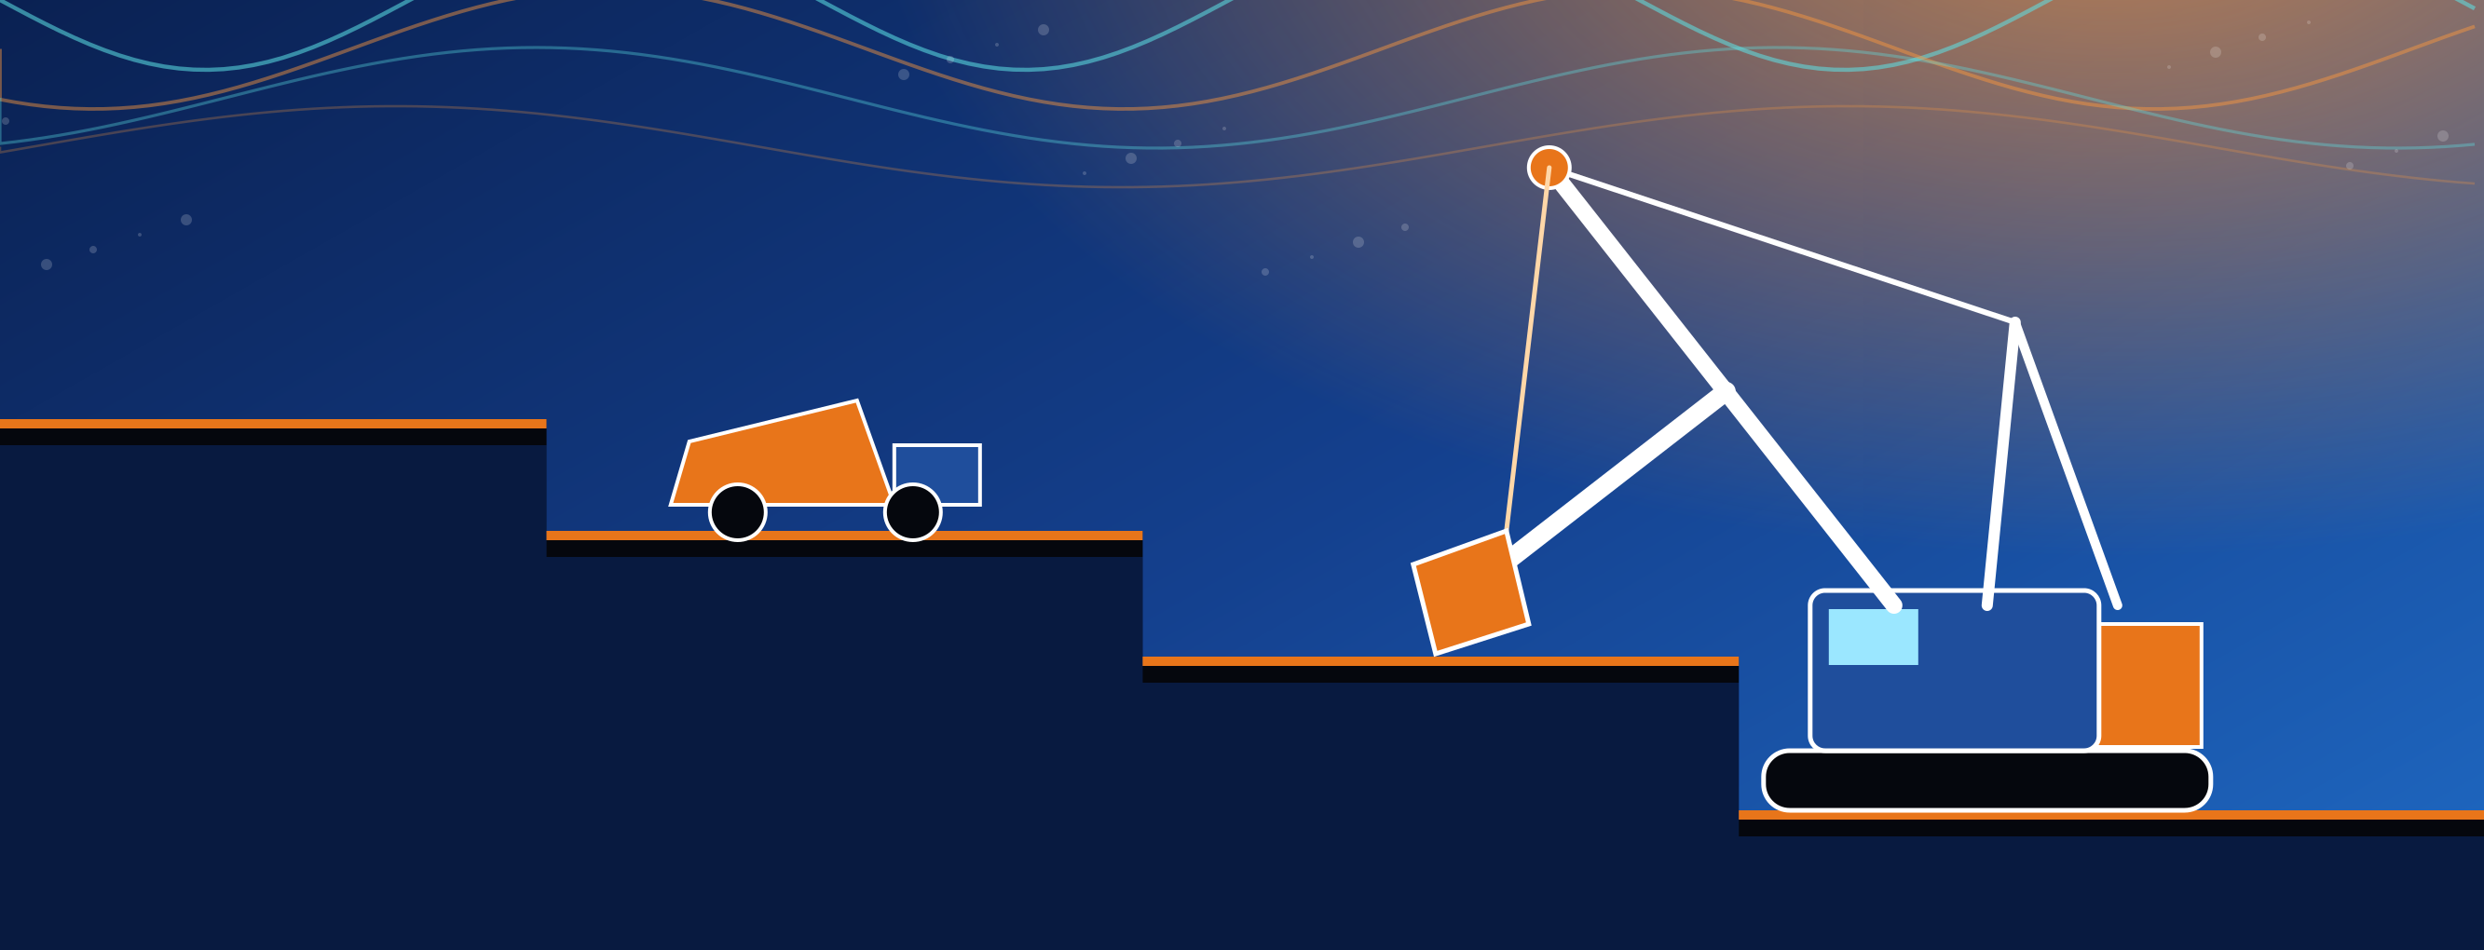
INDUSTRIAL CONTEXT: WHY SHOVEL HEALTH AND PAYLOAD MATTER
> US$100,000
up to 120 t
per hour of normal shovel operation (Rasuli, 2012)
dipper capacity per scoop; trucks to ~400 t
≈ 10 %
36 t
typical commercial payload-monitor error (Rasuli, 2014)
nominal payload, Amlohri WK-20 TZ rope shovel
Why this matters for the research
Overloaded trucks lose engine, tyre and frame life; underloading wastes production
Motor currents mix three causes – commanded motion, external load and machine condition – so condition cannot be read directly from the signal
Existing payload monitors ignore the digging cycle, where loads and faults matter most
Artwork is illustrative vector art (not a photograph, not a result). Real mine photographs can replace it in the same frame.

Slide 4
RESEARCH ARCHITECTURE: NINE-MILESTONE ROADMAP
M1
2-DOF model validation
M3
Momentum observer
M5
Motor-current torque map
M7
Digging-force model
M8
Field validation (CMPDI data)
M2
Load-torque recovery
M4
Measurement-noise robustness
M6
4-DOF extension
M9
Physics-informed learning layer
Complete
Active (P01–P03 closed, P04 run, P05 incomplete, P06 partial)
Planned
Notes:
Redrawn natively from M1/thesis/figures/fishbone_thesis (and Stage-1 report Figure 7). Long-term milestones are roadmap, not achieved results.

Slide 5


THE SYSTEM: FROM CABLE SHOVEL TO TWO-DOF ABSTRACTION
Dipper–handle subsystem only: saddle rotation q₃ (revolute) and crowd extension d₄ (prismatic); swing, hoist rope and boom compliance enter at M5–M6
Parameters from Rasuli et al. (2014) Table II (P&H 2100); lever arm r = d₄ − 1.32 m (1.5 m datum − 2.82 m COG offset)
Project-generated schematics (not to scale). Source: M1/comms/figures.

Slide 6
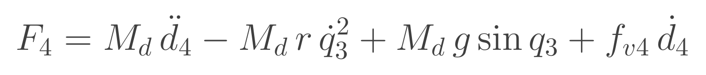
GOVERNING EQUATIONS (EULER–LAGRANGE, 2-DOF)
Saddle (revolute) joint
Crowd (prismatic) joint
Lever arm
Assumptions (Stage 1)
Planar, rigid, constant parameters
Viscous friction only; Coulomb (340 N·m, 480 N) excluded
No external force in M1
M_d: dipper+handle mass; I_zz: inertia about COG (no double counting); f_v: viscous friction
Coriolis 2M_d r ḋ₄q̇₃; centrifugal relief −M_d r q̇₃²
Typeset in LaTeX. Source: Stage-1 report Eqs. 3–4; claims.md (I_zz about-COG, closed 2026-07-23).

Slide 7

M1 IMPLEMENTATION: SIMSCAPE MULTIBODY REFERENCE MODEL
Oracle construction
Revolute joint (saddle) + prismatic joint (crowd) between Boom Base and Dipper Handle
Motion-prescribed by sine inputs; joint torque and force sensed
Logged: q₃, q̇₃, q̈₃, d₄, ḋ₄, d̈₄, τ₃, F₄
Built from part definitions – never sees the hand-derived algebra
Actual Simulink canvas (ShovelSimulatorr2025b), supplied screenshot. Variable-step solver, 30 s stop time.

Slide 8


M1: ANALYTICAL MODEL VS SIMSCAPE ORACLE
Joint | R² | RMSE
Revolute (τ₃) | 1.000000 | 0 N·m
Prismatic (F₄) | 1.000000 | 0 N
Agreement with an independent, noise-free Simscape reference with sensed accelerations. Establishes algebraic consistency – NOT field accuracy.

Slide 9

M1: BLIND PARAMETER IDENTIFICATION
Parameter | Identified | Ground truth
M_d (kg) | 54,300.0 ± 0.0 | 54,300
c (m) | −1.3200 ± 0.0000 | −1.32
I_zz (kg·m²) | 287,900 ± 0 | 287,900
f_v3 (N·m·s/rad) | 3,800.0 ± 0.0 | 3,800
f_c3 (N·m) | 0.0 ± 0.0 | 0 (excluded)
Truth values are literature (Rasuli 2014) parameters embedded in the simulation – recovery is of simulation parameters, not of a real machine
Zero-width intervals are a noise-free-simulation effect; real data will reopen them
Source: stage1_results.mat; claims.md.

Slide 10

DIAGNOSTIC: LOW ACCELERATION ERROR ≠ UNBIASED PARAMETERS
Differentiated vs sensed
Numerical differentiation: NRMSE ≈ 0.79 %
Identified I_zz = 125,804 kg·m² (truth 287,900); truth outside CI
Inertia is ≈0.4 % of torque, so differentiation noise lands on it
Requirement for the field phase: sensed or observer-based acceleration (M3)
Source: claims.md (previous run, same script); fig_C1 from the Stage-1 frozen run.

Slide 11

M2: CONTROLLED EXTERNAL-LOAD RESIDUAL INVESTIGATION
Setup and scope
External Force and Torque block injects a known force at the bail station d₄ + 1.5 m
Motion-prescribed joints; exact sensing; M1 model frozen
Verifies the force mapping and subtraction identity
Does NOT show real unknown-load identification; oracle shares assumptions A1–A3
Actual Simulink canvas (M2_LoadInjection), supplied screenshot. Sources: M2_README.md; claims.md.

Slide 12
M2 PROTOCOL STATUS (7 SEPTEMBER 2026)
Protocol | Content | Status
P01 | Zero-force gate | Completed
P02 | Known-load recovery (100 kN) | Completed
P03 | Amplitude sweep (10–1000 kN) | Completed 2 Sep
P04 | Frequency sweep | Executed; spec completed retrospectively
P05 | Configuration sweep | Parameterisation/readback initiated; incomplete
P06 | Station-confounding diagnostics | Partial; run out of sequence
P07 | Model perturbation | Not started
P08 | Held-out validation | Not started
Note: M2_README.md still lists P04 as "not started"; claims.md and the saved .mat sweep files (verified 4 Sep) show it was executed. claims.md is authoritative.

Slide 13

P01 ZERO-FORCE GATE: NUMERICAL FLOOR
Result
Max |saddle residual| ≈ 2.00×10⁻⁶ N·m
Max |crowd residual| ≈ 2.91×10⁻¹⁰ N
Relative: 7.04×10⁻¹³ and 6.46×10⁻¹⁶
Floating-point floor, zero external load
Plot: M2_fig2_recovery_error (project-generated; zero-force floor 2.00e-06 N·m).

Slide 14

P02–P03: KNOWN-LOAD RECOVERY AND AMPLITUDE SWEEP
Results
P02: 100 kN vertical sinusoid at d₄+1.5 m; slope −1.000000 (sign follows residual = −JᵀF)
P03: 10, 50, 100, 200, 500, 1000 kN; slope −1.000000 on both channels
Absolute error ≈ 2.0×10⁻⁶ N·m; relative error ∝ 1/F
Controlled simulation only. Does not demonstrate physical shovel linearity or a realistic load envelope. Figure: M2_fig3 (single-case verification).

Slide 15
P04 FREQUENCY SWEEP: STROKE-DEPENDENT BEHAVIOUR
Family | 1−r(s_load, s_full) at 0.314 → 1.36 rad/s
Wide | 0.1778 → 0.000769 (231× worse)
Narrow | 8.07×10⁻⁶ → 8.53×10⁻⁵ (≈10× better)
Frequencies: 0.314, 0.5, 0.7, 1.0, 1.36 rad/s
Common-frequency excitation keeps inertia/Coriolis ratio at 18.1–19.0 (both ∝ ω²)
A pre-registered prediction (r ≈ 0.96) was refuted: measured 0.9986
Limitation: P04 specification was completed retrospectively, not frozen before execution. Narrow-case gain is small in absolute terms.

Slide 16
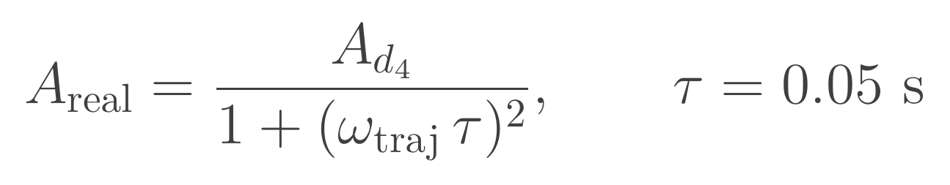
P05 CONFIGURATION SWEEP: PREPARATION ONLY
Step | State
Parameterise crowd trajectory (A_d4, B_d4) | Done
Baseline reproduces earlier result | Done
Motion-input filter effect identified (below) | Done
Spec fields frozen before run | Not done
Full configuration sweep executed | Not done
Realised crowd amplitude (second-order input filter)
Measured half-range 1.999507 m at commanded 2 m matches the second-order form to 6 d.p.
Changing the commanded amplitude therefore changes the realised trajectory
P05 is NOT complete. Receipts (M2_crowdparam_*.mat) are stamped with a DIRTY working-tree commit, so they are not a clean provenance record.

Slide 17


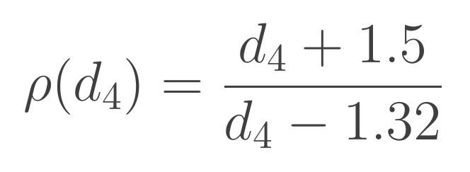
P06: PARTIAL STATION-CONFOUNDING DIAGNOSTIC
Station ratio
True d₄+1.5 vs assumed d₄−1.32 (2.82 m apart)
Wide: 1−R² = 2.69×10⁻³
Bi-matched band: 3.00×10⁻⁵ (89.77×)
Slopes −1.378 (wide) and −1.335 (Bi-matched narrow band) fall inside the predicted ρ range; load/mass correlation 0.822 → 0.99999 (correlation diagnostic only)
Left plot shows an off-band narrow case (57× collapse); the 89.77× case has no saved figure. Formal SVD/condition-number identifiability is outstanding. Bi et al. 9.5–10.04 m is ρ₀, not a d₄ envelope.

Slide 18
CONSOLIDATED M2 FINDINGS
Established (simulation)
Force mapping and subtraction identity exact to numerical floor
Linear recovery from 10 to 1000 kN
Load/mass separability depends on d₄ variation
Differentiated accelerations bias inertia
Not yet established
Formal identifiability (SVD, conditioning, uncertainty)
Decoupled ω_d4 vs ω_q3 excitation
Robustness to model perturbation (P07) and held-out data (P08)
Anything on a real machine

Slide 19
VERIFIED VS UNVERIFIED
Claim | Status
Equations match independent multibody reference | Verified (noise-free simulation)
Blind recovery of five parameters | Verified (simulation)
Residual recovers known injected force | Verified (controlled simulation)
Field validation / real unknown-load recovery | Not demonstrated
Fault diagnosis, degradation, RUL | Not demonstrated
Digital-twin deployment | Not demonstrated
PINN + momentum observer novelty | Not claimed; positioning under review

Slide 20
FIELD TRANSITION AND DATA REQUIREMENTS
Required from CMPDI / NCL
Motor currents and joint signals at ~30 Hz
Hoist field-current log (K_H varies with field current)
Weighbridge ground-truth payload per pass
P&H/WK-20 crowd stroke and velocity limits
Historical fault and breakdown records
Target machine
Amlohri WK-20 TZ electric rope shovel: nominal payload 36 t, AC drives (Siemens S120), hoist 2×600 kW, crowd 350 kW
Detailed data-requirements document (CMPDI shovel phase) already prepared
October 2026 field engagement: no analysed field data exist
Sources: AMLOHRI WK-20 specification; Stage-1 report §6.2; repo meetings/ folder.

Slide 21
NEXT STEPS
Step | Action
Now | Freeze P05 spec; run configuration sweep from a clean commit; decouple ω_d4 and ω_q3
Now | Formal scaled sensitivity matrix, SVD, condition number, uncertainty
Next | P07 model perturbation; P08 held-out validation
Then | M3 momentum observer; M4 noise; M5 motor-current map
Gate | M8 reality check on CMPDI data against weighbridge truth
Later | M9 drift tracking and physics-informed learner

Slide 22
CONCLUSIONS AND REQUESTED SUPPORT
Conclusions
Exact, independently validated 2-DOF subtraction reference built (M1)
Controlled external-load recovery shown in simulation (P01–P03); P04 and P06 define the identifiability limits
Honest boundary: simulation only, no field validation yet
Support requested
Access to the shovel data in the requirements document
Weighbridge-referenced payload records
P&H/WK-20 crowd stroke and velocity limits
Guidance on field-visit scheduling

Slide 23
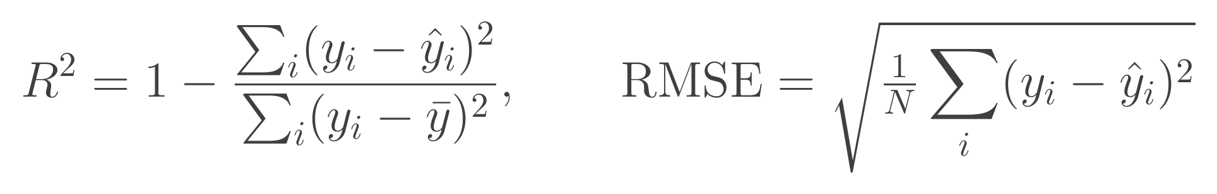
APPENDIX: PROVENANCE AND LIMITATIONS
Fit metrics (Fu et al. 2022, Eq. 18)
Repository: github.com/sonu037/shovel_dynamics, last commit 460d872 dated 7 Sep 2026; authority order claims.md → evidence artifact → research_log.md
Literature values (Rasuli 2014 Table II) are not our estimates; the static case differs (M_d 56,900 vs 54,300 kg)
Struck claim: "Rasuli R² = 0.942" does not exist in the paper
P04 spec retrospective; P05 receipts from a dirty tree; P06 out of sequence
Rasuli 2014 field result: 8,402 vs 8,420 kg (σ = 104 kg) in swing regime – literature, not ours

Slide 24
APPENDIX: REFERENCES
A. Rasuli, S. Tafazoli, W. G. Dunford, "Dynamic modeling, parameter identification, and payload estimation of mining cable shovels," IEEE IAS Annual Meeting, 2014
A. Rasuli, PhD thesis, University of British Columbia, 2012
S. Frimpong, Y. Hu, K. Awuah-Offei, "Mechanics of cable shovel-formation interactions…," J. Terramechanics 42, 2005
T. Fu et al., "Novel hybrid physics-informed deep neural network for dynamic load prediction of electric cable shovel," Chin. J. Mech. Eng., 2022
S. Tafazoli, P. Lawrence, S. Salcudean, "Identification of inertial and friction parameters for excavator arms," IEEE Trans. Robot. Autom. 15(5), 1999
Q. Bi et al., Energies 13(3):3118, 2020

Slide 25
THANK YOU

